Slide 1
Applicant Reception
March 23, 2019
Notes:
Suggested speaking points
Hi everyone! Welcome to the [insert academic area] Applicant Reception.
Thanks for joining us.
I will first begin with our Indigenous land acknowledgement.
Georgian College acknowledges that all campuses are situated on the traditional land of the Anishnaabeg [Ah-nish-NAH-beg] people.
The Anishnaabeg include the Odawa [Oh-DAH-wah], Ojibwe [oh-JIB-way] and Pottawatomi [Boh-tah-WAH-toh-mee] nations, collectively known as the Three Fires Confederacy.
Georgian College is dedicated to honouring Indigenous history and culture and committed to moving forward in the spirit of reconciliation and respect with all First Nations, Métis [MAY-tee] and Inuit people.
[]
Today is all about showing you where your program can take you.
We’ll start by offering a bit of information about Georgian College
Then we’ll invite a graduate to the stage to tell their story
[You’ll hear from an employer]
We’ll open the floor to questions
And then we’ll all have some time to mix and mingle

Slide 2
[NAME OF EMCEE]
[TITLE OF EMCEE]
[email address]
[phone number]
[office room number, building]
Notes:
Suggested speaking points
Before we get started I’d like to introduce myself. I’m [first and last name] and I’m the [title] of [area] at Georgian.
I joined the team at Georgian in [year]. Before that I [briefly describe work and/or industry experience].
I’m so proud of the work we do in [area] and know you’ll enjoy learning from our team of industry experts.
But if you’re asking yourself “Why should I choose [academic area at Georgian OR Georgian]?” allow me to tell you a bit about why I think we’re exceptional.

Slide 3
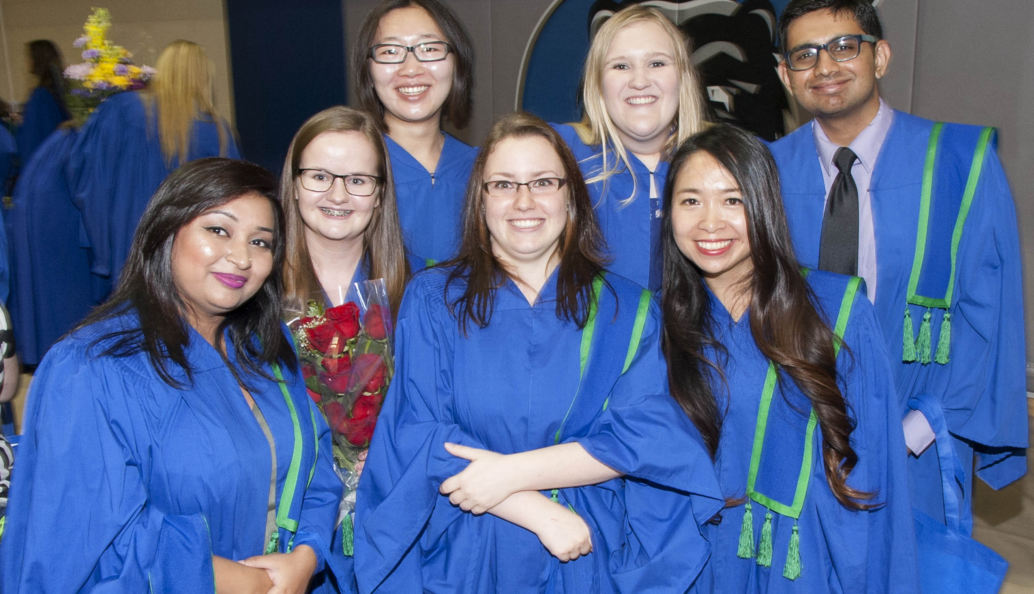
FOLLOW YOUR PASSION
TO YOUR DREAM JOB
Notes:
Suggested speaking points
First, our grads get jobs: [select one of these two stats]
90.3% of Georgian alumni are employed within six months of graduation.
[Academic area employment rate] of alumni in [name of academic area] get jobs within six months of graduation

Slide 4
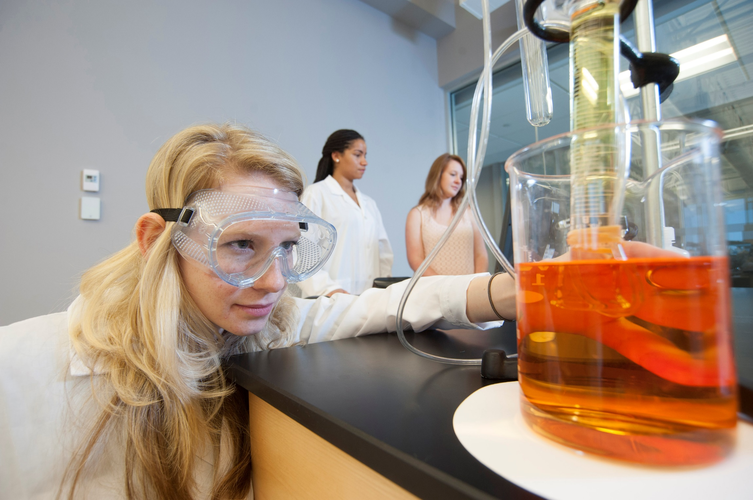
EXPERIENCE HANDS-ON
LEARNING
GAIN EXPERIENCE
Notes:
Suggested speaking points
Our programs emphasize practical, hands-on learning. [Select the proof points that are most relevant to your area, or add your own]:
Georgian partners with 6,200 employers to give students work experience and strong networks
Most programs offer a work-integrated learning opportunity
More than 5,000 Georgian students are currently enrolled in a program with paid co-op
Whether students are learning in classrooms, in labs, or in the workplace, we focus on building the practical skills employers are looking for.
We invest in the latest technology and equipment so that what you’re learning in labs is cutting edge and relevant.

Slide 5
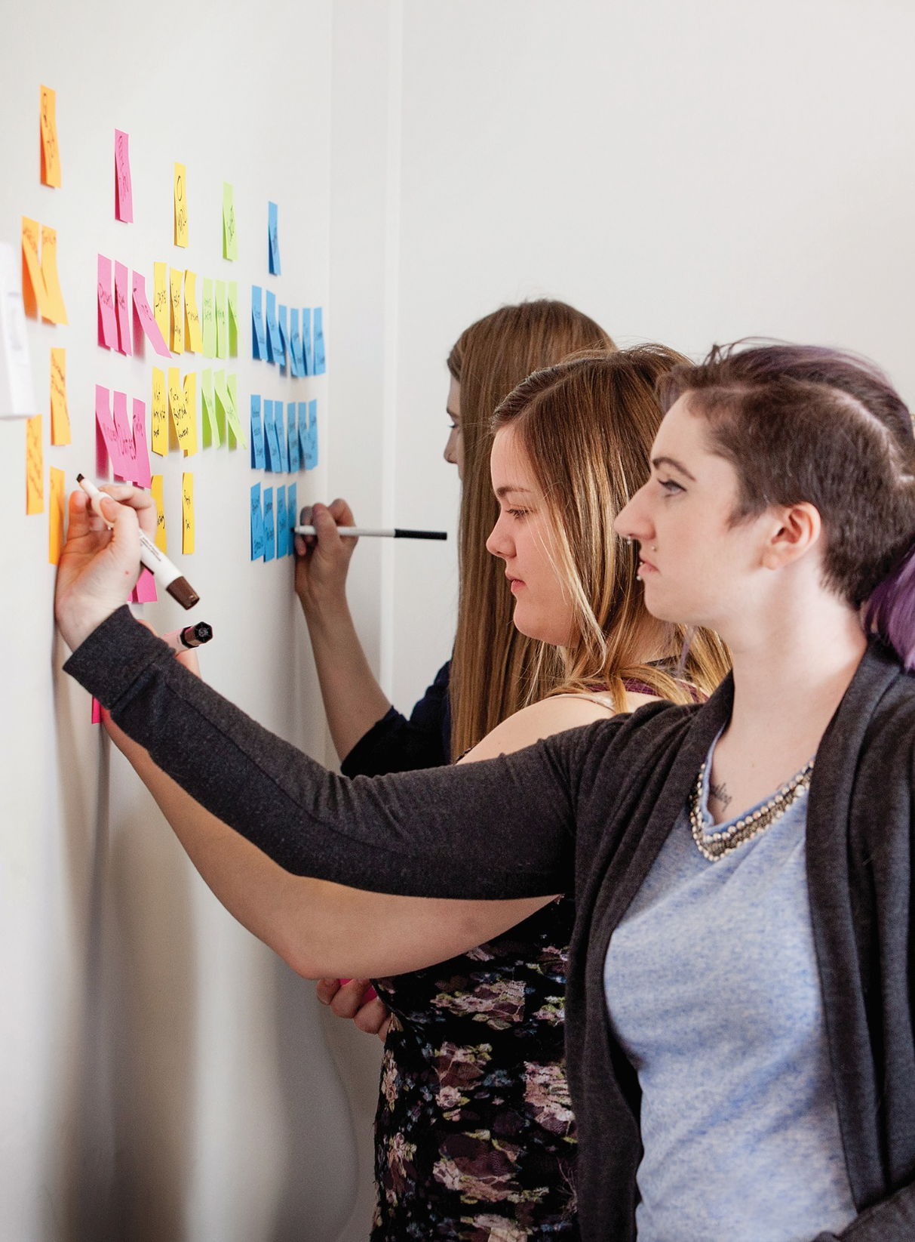
BECOME A CHANGEMAKER
Learn to use creativity, collaboration and problem-solving to respond to issues and affect positive social change.
Tap into the world’s largest network of social entrepreneurs and changemakers.
Notes:
Suggested speaking points
Second, we teach our students to be innovators and leaders in their communities and workplaces.
Did you know Georgian is Canada’s first designated changemaker college?
Our students have access to the world’s largest network of social entrepreneurs and changemakers through AshokaU.

Slide 6
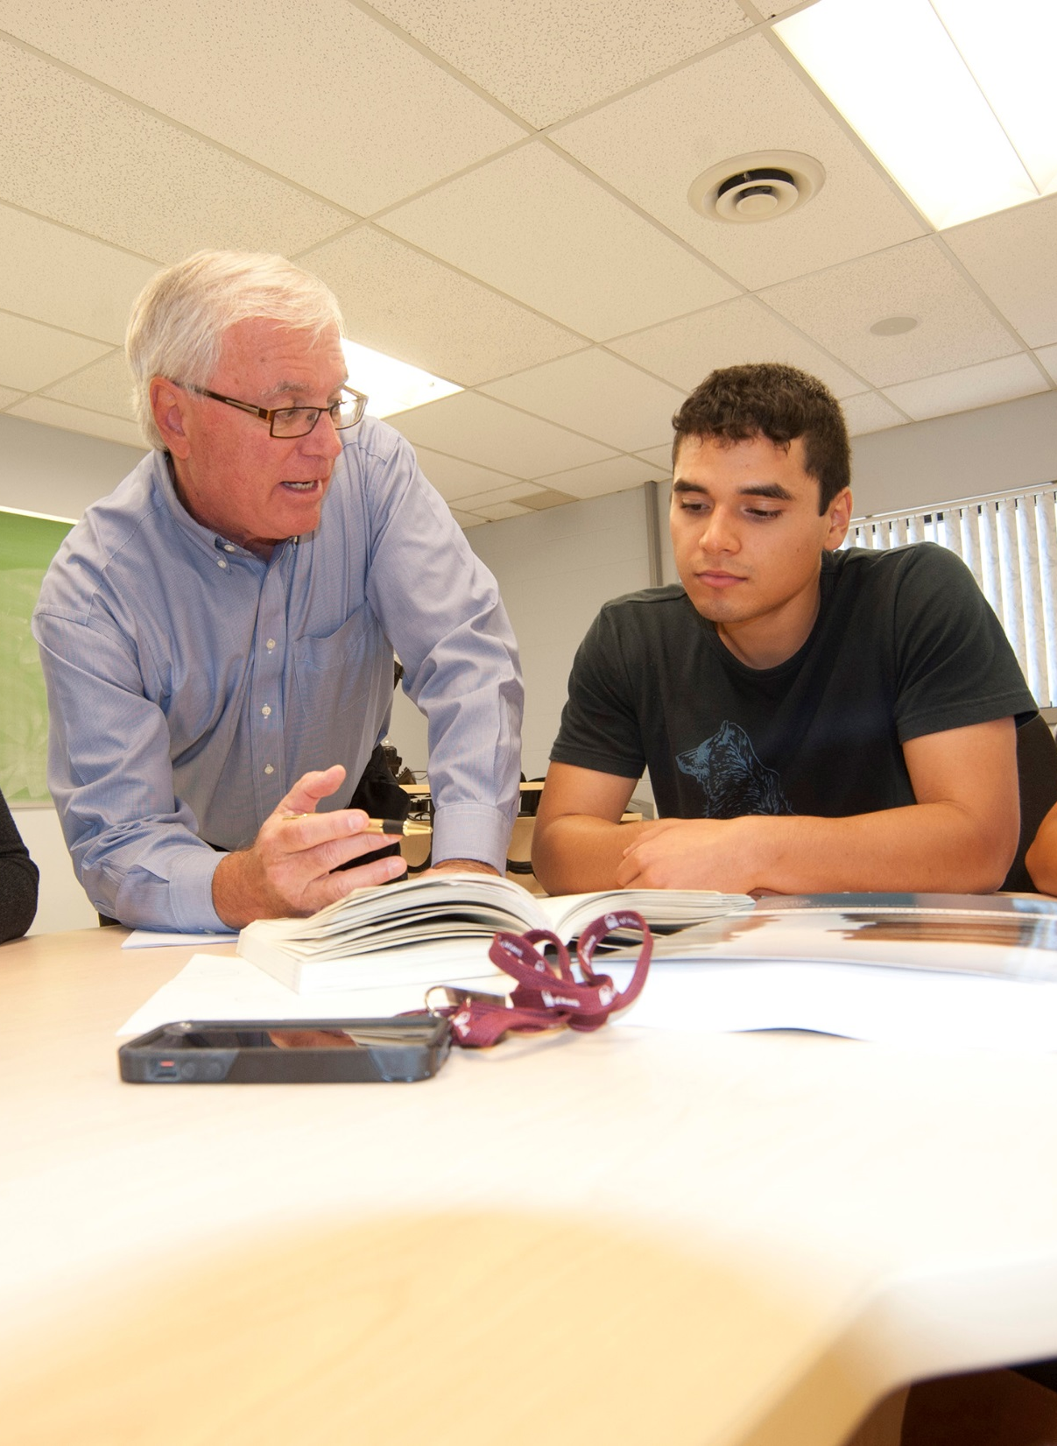
A UNIQUE EXPERIENCE
Faculty with industry expertise
Friendly and supportive staff
Inclusive culture
Dedication to your success
Notes:
Suggested speaking points
Finally, we offer a truly unique and positive experience in postsecondary education.
Day in and day out I see the outstanding commitment of faculty and staff to student success. [If possible, provide an example from your area]
Your instructors are industry experts. They offer relevant, market-driven knowledge.
But beyond that, this campus provides a friendly and inclusive culture – and a level of support I haven’t seen anywhere else.
That’s why, when you leave Georgian, you’ll have the skills you need, the mindset to succeed, and the confidence to thrive.

Slide 7
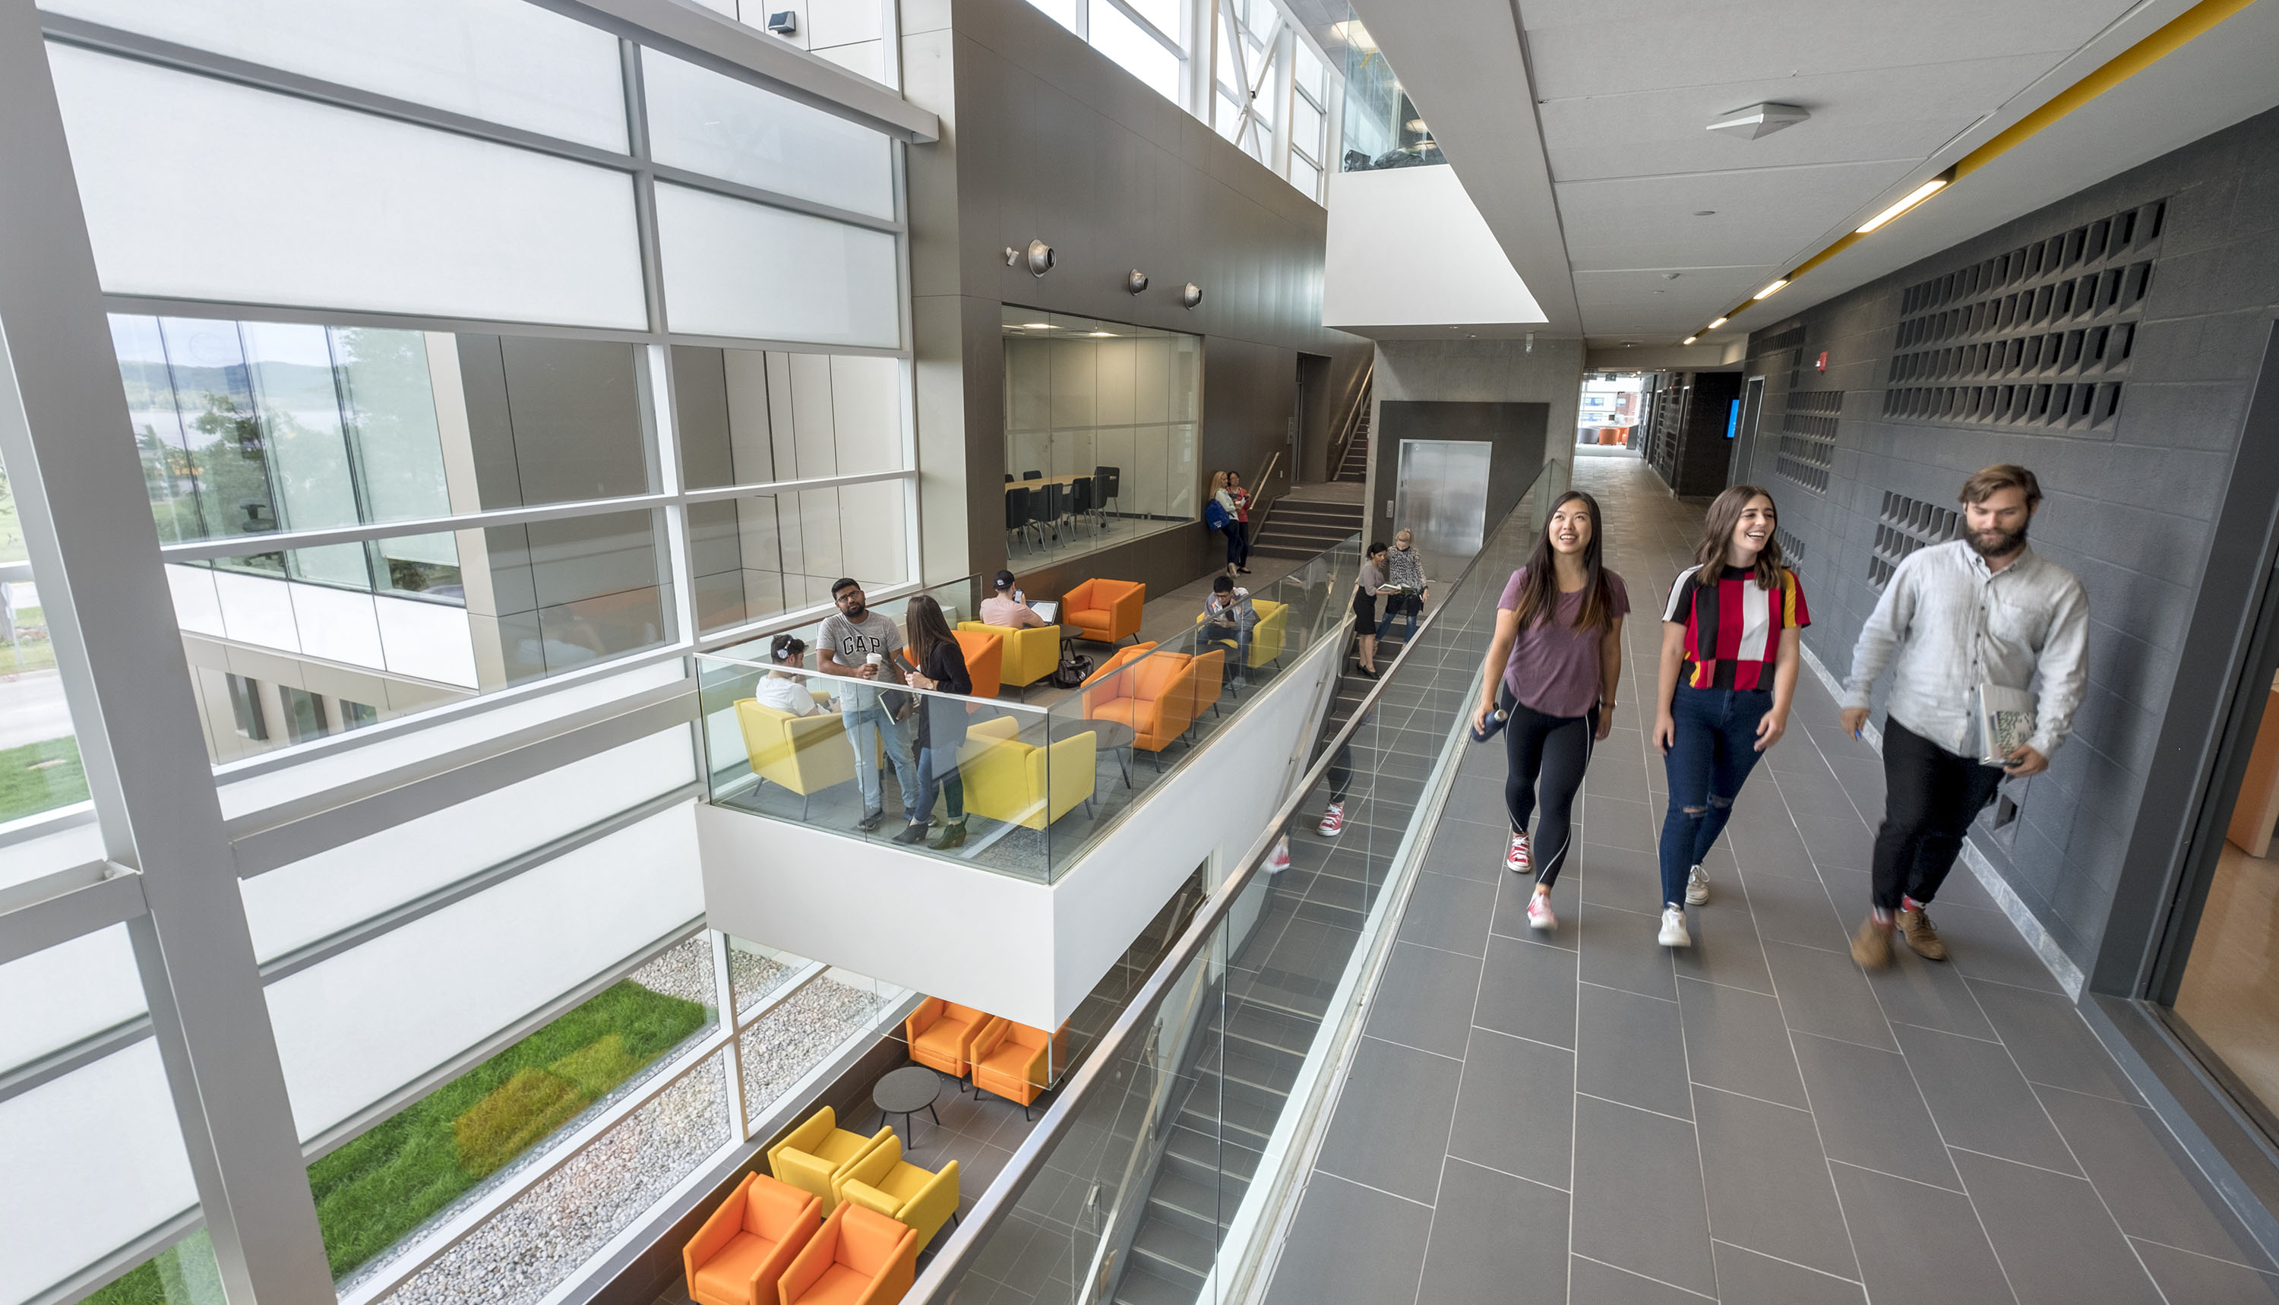
BARRIE CAMPUS
Notes:
OPTIONAL SLIDE - Now I’d like to tell you a bit about this campus…
Key proof points – Barrie Campus
The largest of Georgian’s seven campuses, the Barrie Campus is a community within a community – a welcoming and safe place to study, with all the amenities.
Barrie is known for its friendly residents and four-season lifestyle. With a gorgeous waterfront on Kempenfelt Bay, nearby trails and ski hills, several shopping malls, a vast assortment of restaurants and great nightlife – there is plenty to do when you’re not studying.
Campus features
Art gallery, Bear Essentials store, Research and Innovation department, the brand new Peter B. Moore Advanced Technology Centre, fitness centre with climbing wall and gymnasium, Henry Bernick Entrepreneurship Centre, Indigenous Resource Centre, innovation labs and changemaker spaces, library, on-campus residence, nursing simulation labs, Segal International Centre, the Sadlon Centre for Health, Wellness and Sciences, community health and wellness clinics, student lounges, theatres, and videoconferencing.
Student fitness
9,000-square-foot fitness centre with the latest equipment, 147-metre suspended running track, Olympic-sized gymnasium and state-of-the-art climbing wall. The J.C. Massie Field is a FIFA-certified sports field.
Campus eats
Bun on the Run, Georgian Dining Room, cafeteria including Pizza and Subway, the First Class Café, the Last Class Bar and Grill and two Tim Hortons.
Student residence
Our on-campus residence provides modern, convenient accommodation; suites include two or three individual bedrooms with a double bed, large desk, dresser, high-speed internet, telephone with local service, TV with satellite service, three-piece bathroom with shower and a kitchen with microwave/convection oven, full-sized fridge, and more.

Slide 8
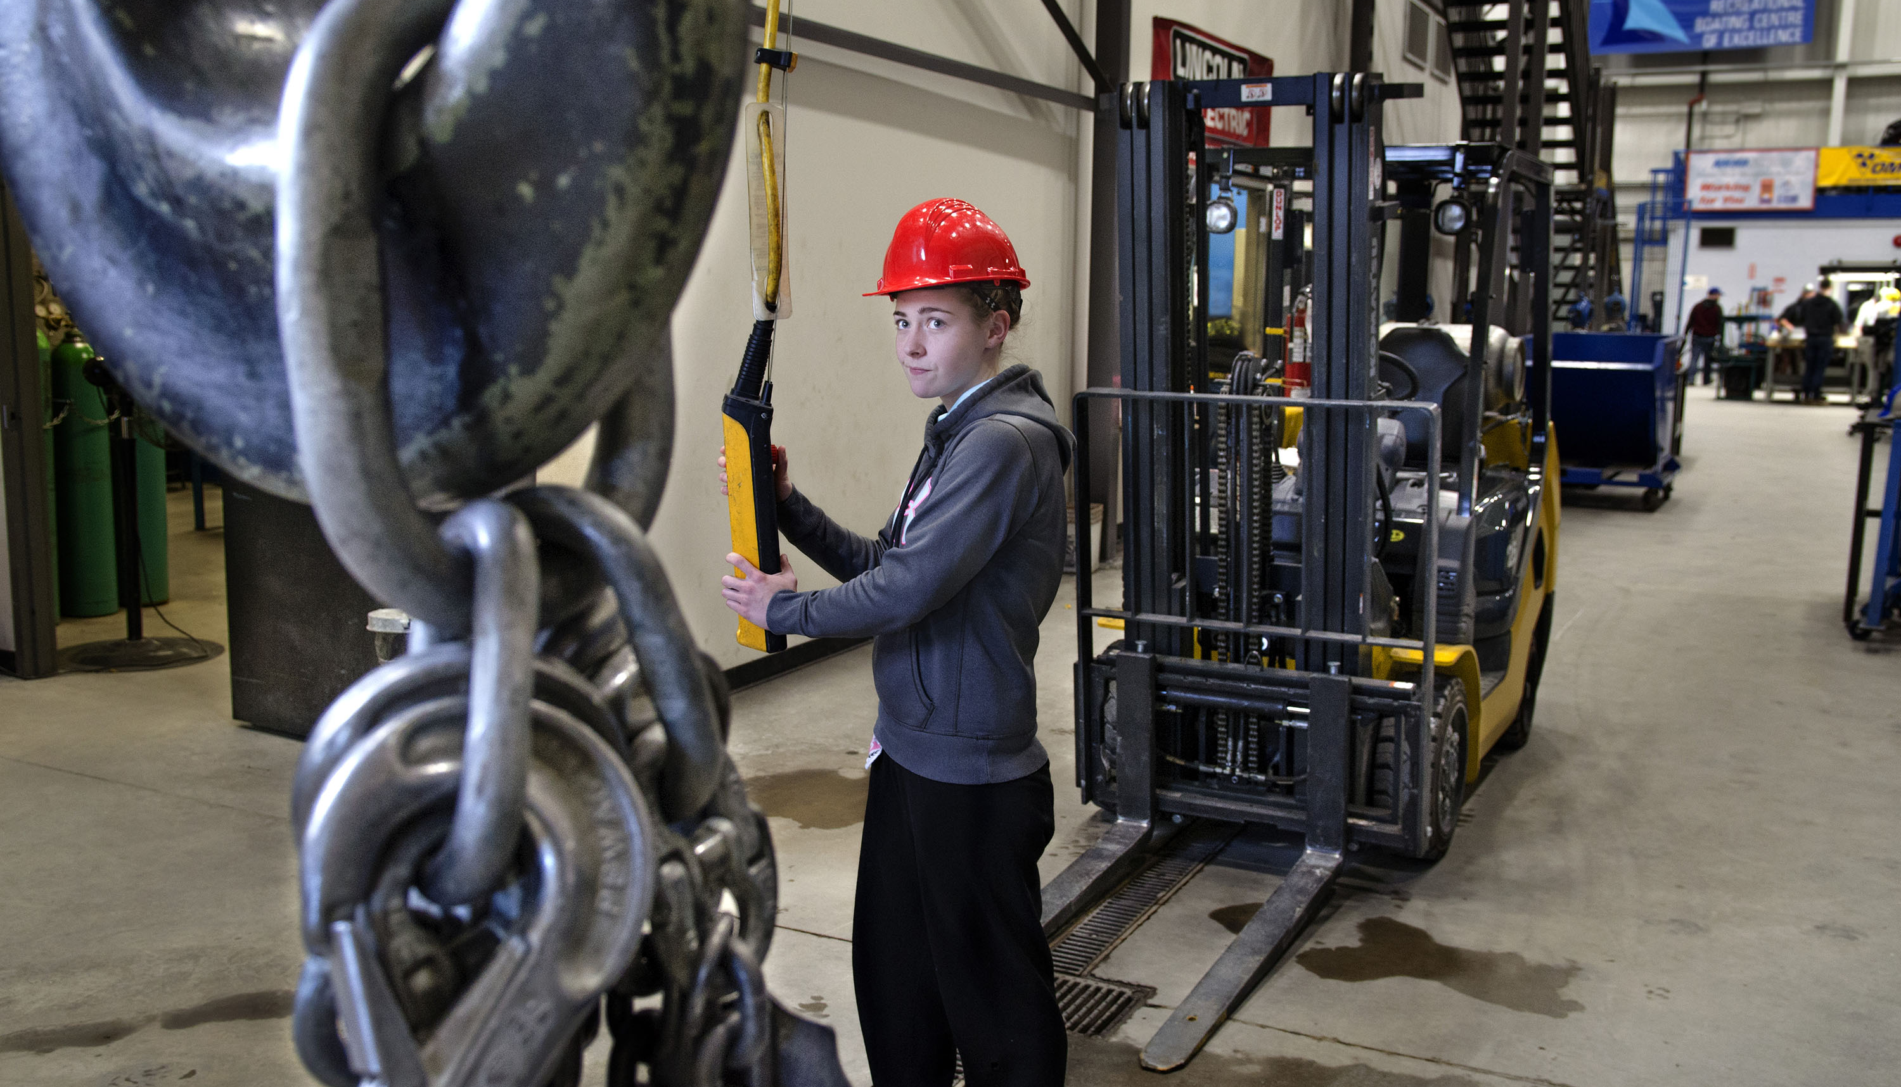
MIDLAND CAMPUS
Notes:
OPTIONAL SLIDE - Now I’d like to tell you a bit about this campus…
Key proof points – Midland Campus
The Robbert Hartog Midland Campus is known for offering exceptional apprenticeship and skilled trades training – providing industry with a vital, highly qualified workforce.
There’s a lot to do in Midland year-round, including boating and snowmobiling. Located on the shores of Georgian Bay, it’s also known for its quaint downtown and rich history.
Campus features
67,000 square feet of learning space, almost 20 acres of property, 39,000 square feet of dedicated shop space, Indigenous Resource Centre, cafeteria, Recreational Boating Centre of Excellence, Skilled Trades Centre, and videoconferencing classroom
Services
We make it easy for you to get the information you need. Georgian College Business and Career Services in Midland is your friendly, FREE, helpful source for information on:
courses and programs offered at other Georgian campuses
Ontario colleges offering specific career training
student loans (OSAP)
how to apply to postsecondary programs (OCAS)
community services in North Simcoe
apprenticeable trades
labour market information

Slide 9
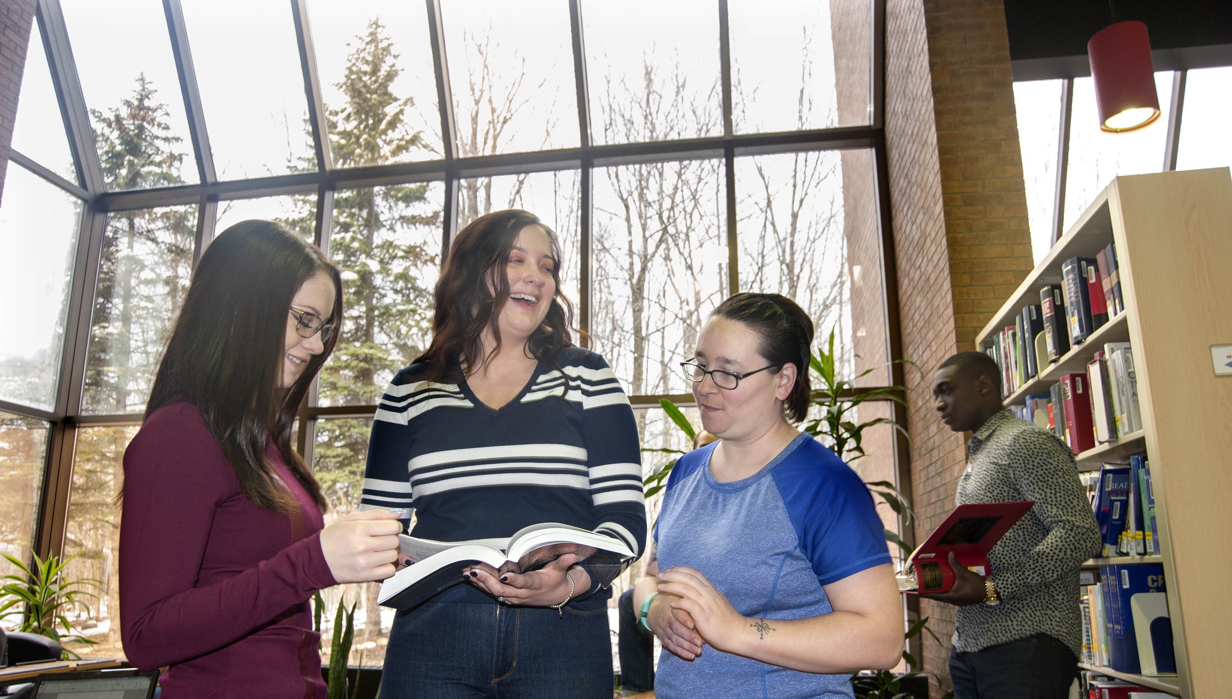
ORILLIA CAMPUS
ORILLIA CAMPUS
Notes:
OPTIONAL SLIDE - Now I’d like to tell you a bit about this campus…
Key proof points – Orillia Campus
The Orillia Campus offers a variety of programs, all the amenities of a larger campus, as well as a friendly environment.
Orillia, known as the Sunshine City, is the gateway to Ontario’s cottage country, with nearby golf courses, lakes and ski hills. In town, you’ll find a great market, restored opera house and Casino Rama – where world-class concerts are held year-round.
Campus features
Bear Essentials store, counselling labs, fitness centre, Indigenous Resource Centre, library, meditative labyrinth, multidisciplinary lab, on-campus residence, Second Life virtual campus, theatre, use-of-force room, veterinary clinic, and videoconferencing classrooms.
Student fitness
Assortment of free weights, change rooms with lockers, shower stalls, and a wide variety of cardio and weight machines.
Campus eats
Cafeteria, The Den Pub and Restaurant and Tim Hortons.
Student residence
On-campus residence is conveniently located; each suite has four bedrooms, each with a double bed and cable outlet; shared kitchen with a full-sized refrigerator, breakfast bar and chairs, stove, oven and dishwasher; a furnished living room with LCD flat screen TV, and more.

Slide 10
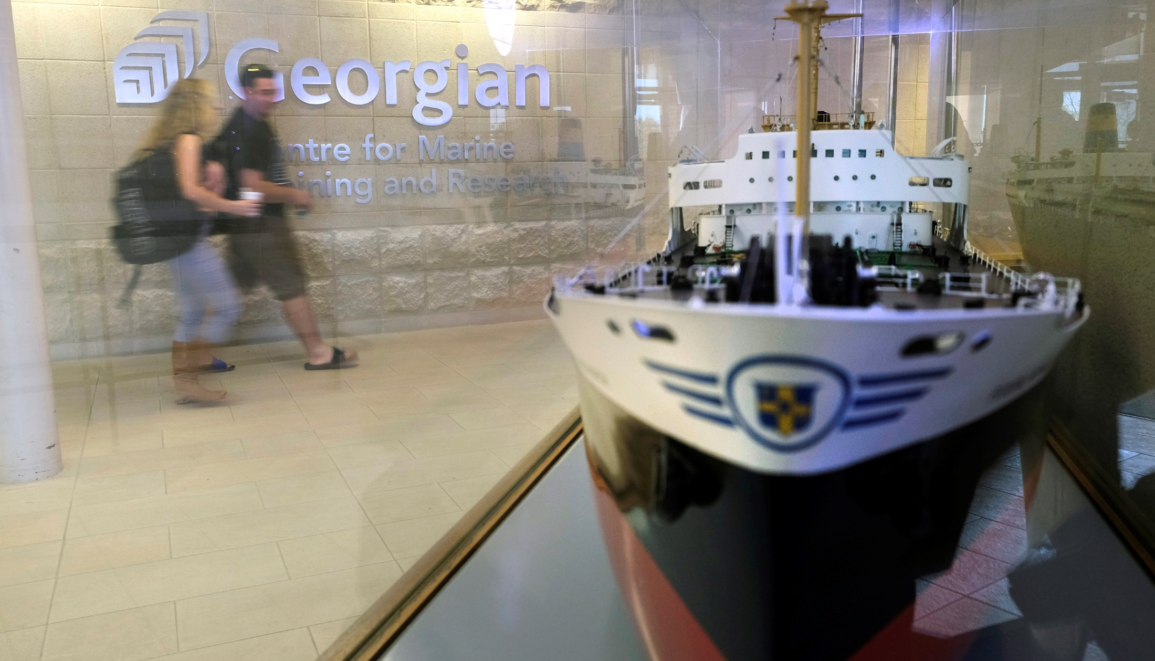
OWEN SOUND CAMPUS
Notes:
OPTIONAL SLIDE - Now I’d like to tell you a bit about this campus…
Key proof points – Owen Sound Campus
The Owen Sound Campus prides itself on being just the right size. It offers a wide variety of programs in great facilities, including Canada’s most advanced marine simulation and research centre.
The historic port of Owen Sound features beautiful waterways and parks. As the largest urban centre in Grey and Bruce counties, it also has a vibrant downtown and all of the amenities of a larger city.
Campus features
Centre for Marine Training and Research and the Algoma Central Corporation Marine Emergency Duties Centre, Bear Essentials store, fitness centre, high-fidelity nursing simulation lab, Indigenous Resource Centre, library, on-campus residence, power engineering lab, skilled trades labs, student lounge, and videoconferencing classroom.
Student fitness
Gymnasium, modern cardio and weight equipment, and stretching room.
Campus eats
Cafeteria, Georgian Dining Room and The Last Class.
Student residence
The student residence is located right next to the Owen Sound Campus and offers everything you need to make your college experience enjoyable and safe. Three-storey suites include four bedrooms, each with double bed, desk with chair, Wi-Fi and cable outlet; a shared kitchen with a full-sized refrigerator, breakfast bar and chairs, stove, oven and dishwasher; a furnished living room with LCD flat screen TV, and more.

Slide 11

AUTOMOTIVE BUSINESS
For the driven
Notes:
OPTIONAL SLIDE – Here’s why I think this academic area is unique…
The Automotive Business School of Canada is the only one of its kind in the country.
Students can gain either a diploma or a degree here – all the while learning about and making connections in the automotive industry.
Diploma and degree programs both offer co-op.
Exceptional scholarships and bursaries exist to support students in these programs.
Graduate employment rate of more than 90 per cent.
Take part in the Georgian College Auto Show, a student-run, outdoor learning lab that allows our students to get hands-on experience with major manufacturers and the public.

Slide 12
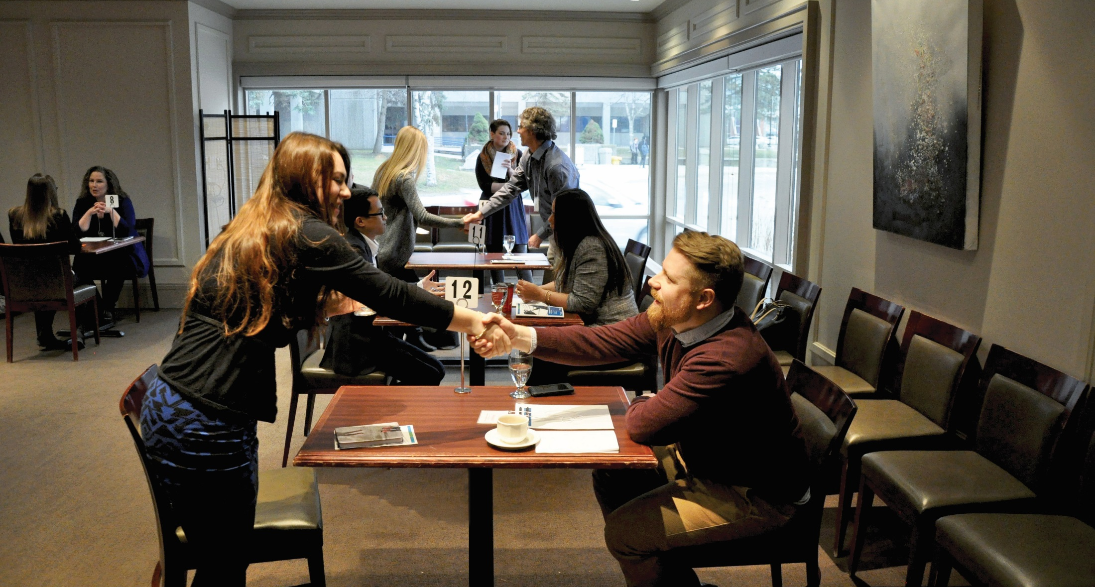
BUSINESS MANAGEMENT
Make your mark
Notes:
OPTIONAL SLIDE – Here’s why I think this academic area is unique…
We offer more than 25 Business and Management programs, including certificates, diplomas, degrees and graduate certificates.
12 of these programs offer paid co-operative work terms.
Several programs are unique to Georgian.
Our business programs offer highly transferable skills…
Or you may be looking for degree completion options – we have those too!

Slide 13
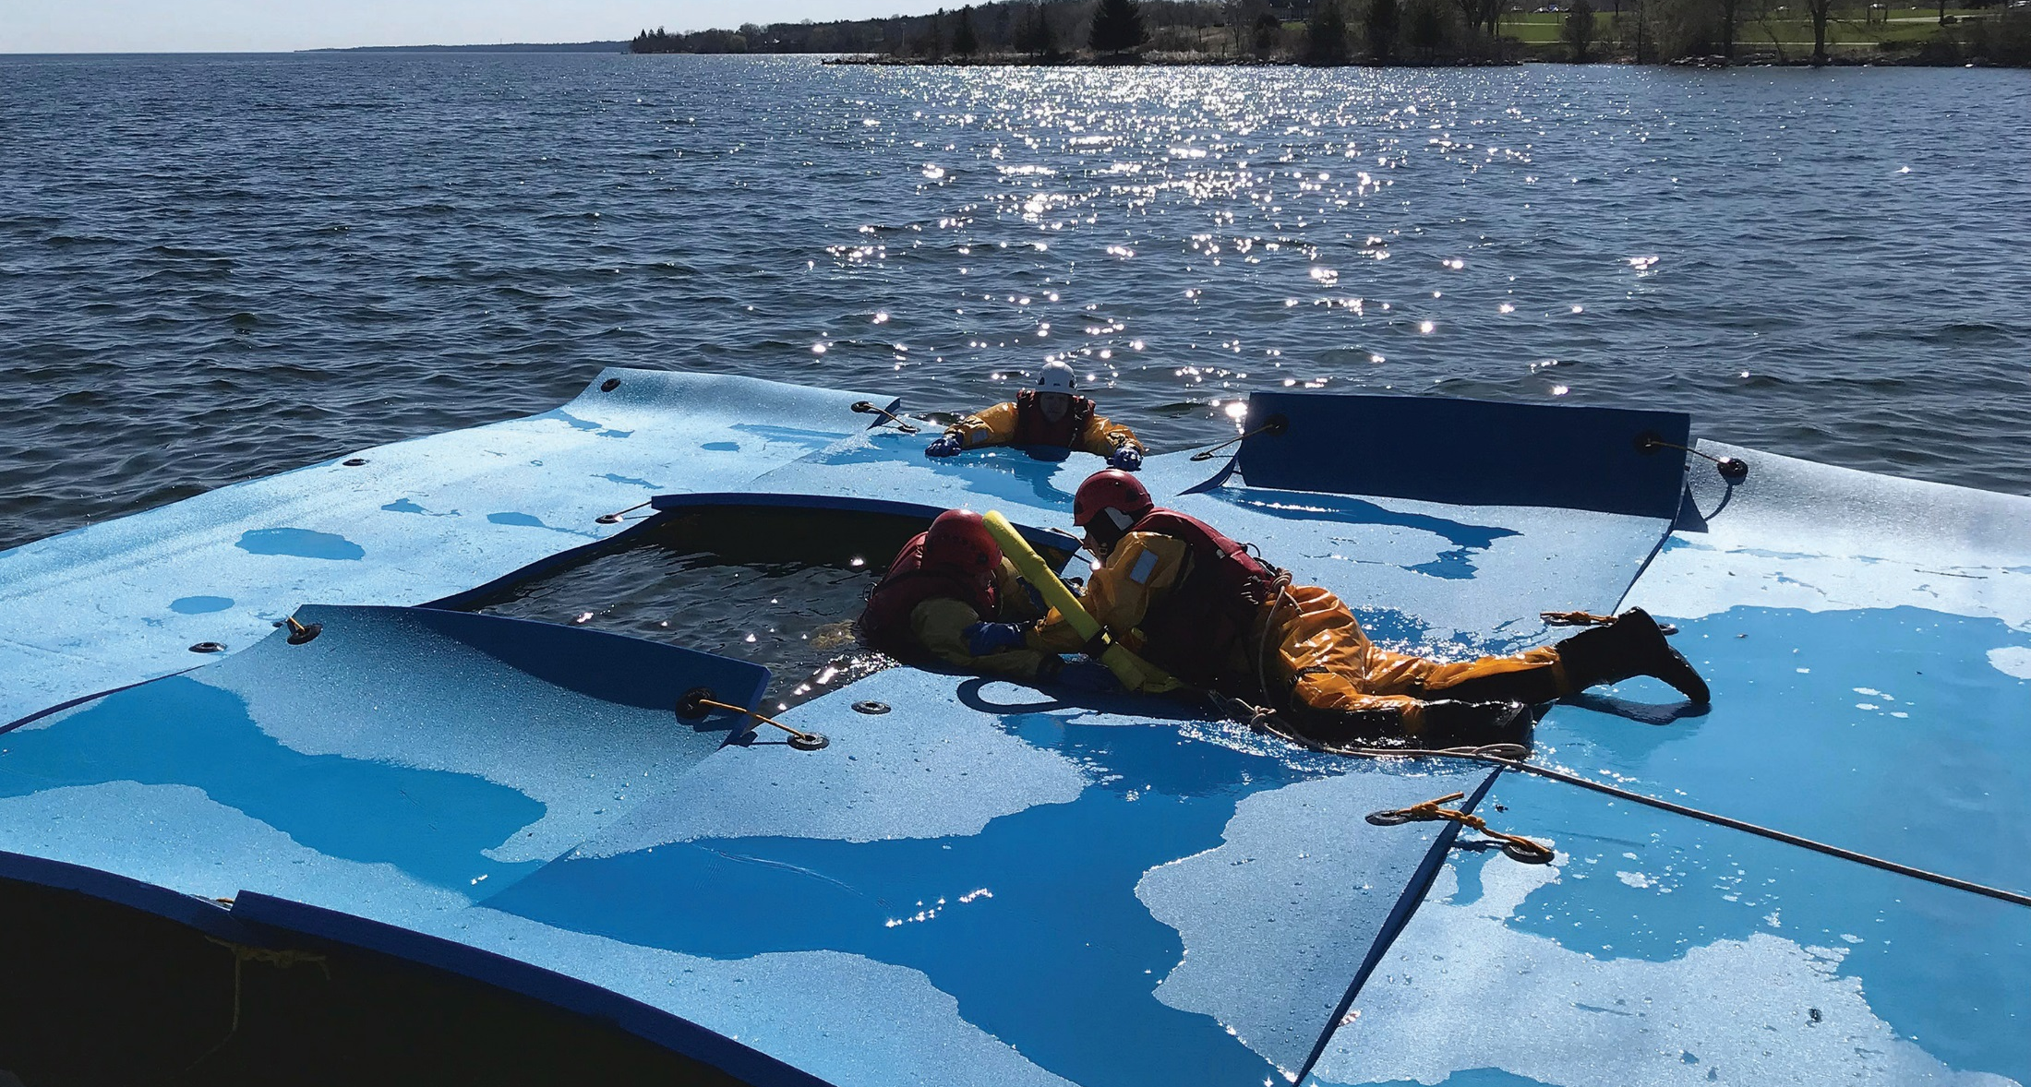
COMMUNITY SAFETY
Answer your call to serve
Notes:
OPTIONAL SLIDE – Here’s why I think this academic area is unique…
Georgian’s Community Safety programs offer rich curriculum in a diversity of disciplines that focus on making a positive impact in the community.
Programs are developed closely with local and provincial employers, so what you learn is cutting edge and applicable to your career.
Students also have opportunities to partner with employers – like the Ontario Provincial Police – on community projects.
We’ve taken steps recently to ensure that students have a chance to explore their chosen fields and can transfer between related programs to best match their interests:
There is a common first year for Police Foundations, Protection, Security and Investigation, and Community and Justice Services programs, for instance.

Slide 14
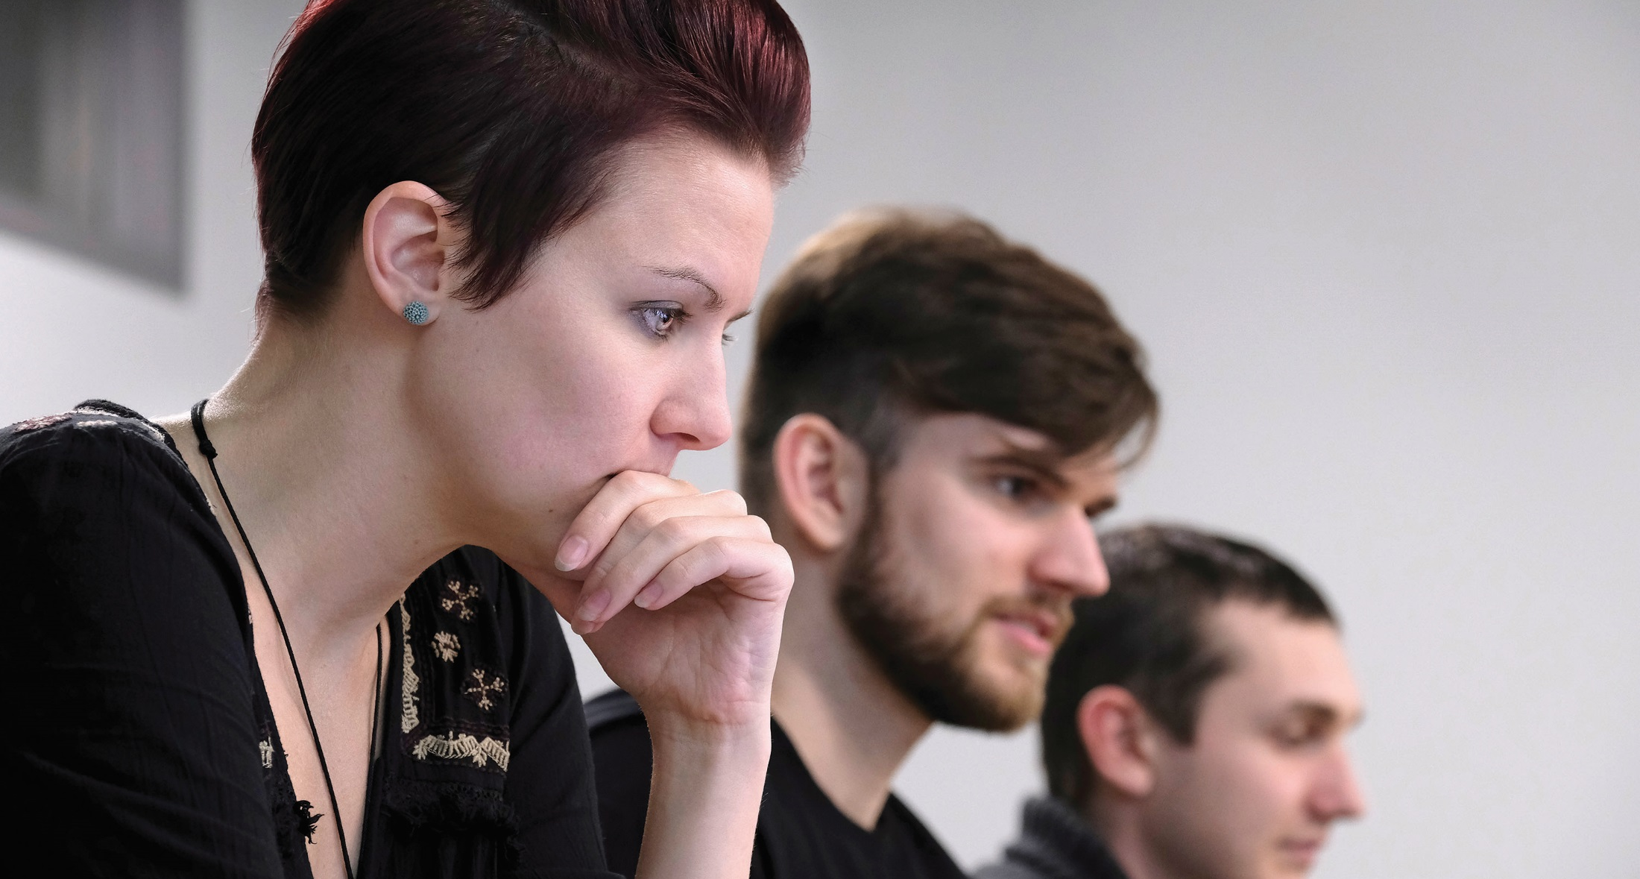
COMPUTER STUDIES
Code your way to your dream job
Notes:
OPTIONAL SLIDE – Here’s why I think this academic area is unique…
Hands-on learning in our classrooms and state-of-the arts labs contributed to employment rates of over 90 per cent for graduates of our Computer Studies programs last year.
Our faculty members are skilled, experienced IT professionals who continually monitor industry trends and requirements to ensure the curriculum remains current and relevant.
In the classroom, we focus on hands-on learning. You will actually do the things employers will expect you to do in the workplace.

Slide 15
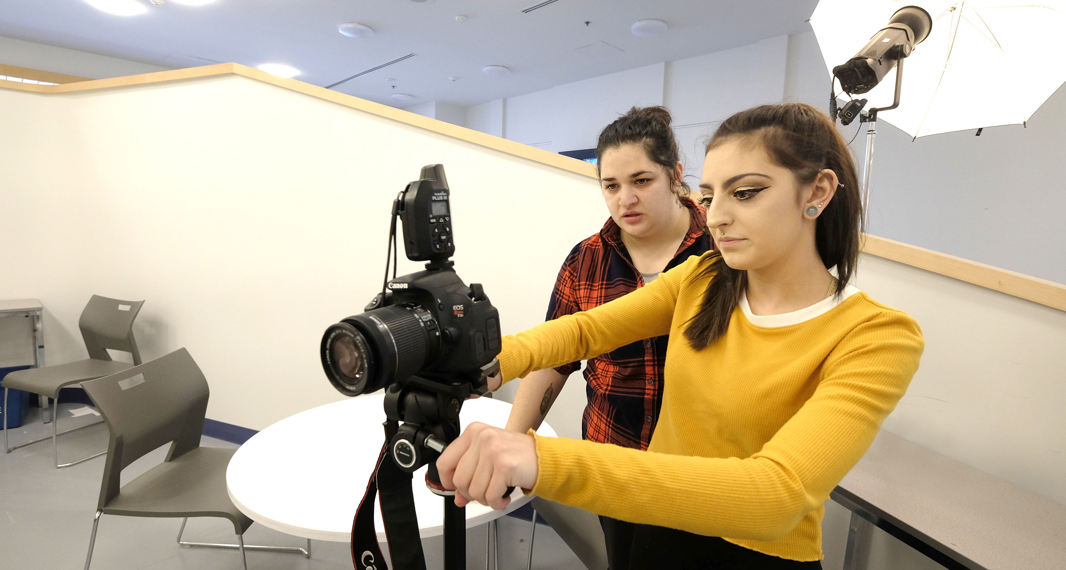
DESIGN AND VISUAL ARTS
Turn creativity into a career
Notes:
OPTIONAL SLIDE – Here’s why I think this academic area is unique…
Whether you’re looking to find your niche in the world of art and design, or if you’re on a fast track to a career, our Design and Visual Arts programs offer a wide variety of general and specialty training across a broad spectrum of subject areas.
Gain exposure through a variety of exhibits and events. Let our inspiring faculty guide you as you turn your creativity into a career.

Slide 16
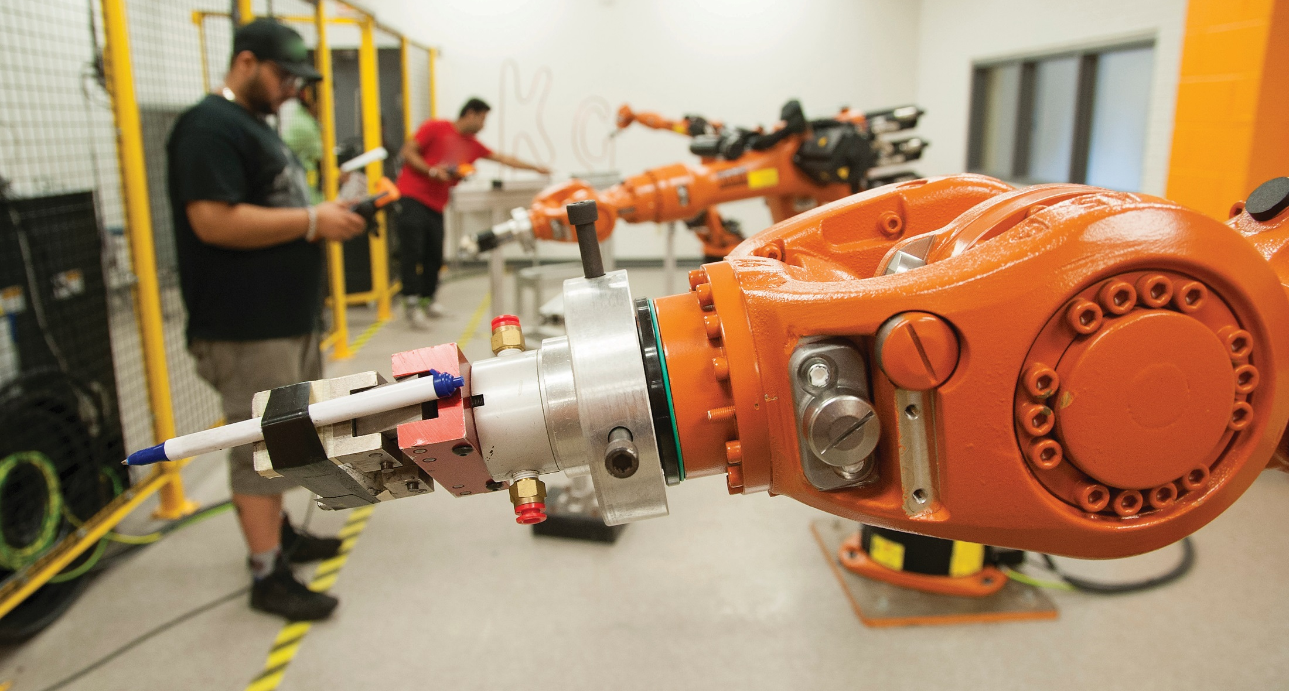
ENGINEERING AND
ENVIRONMENTAL TECHNOLOGIES
Use innovation to create the future
Notes:
OPTIONAL SLIDE – Here’s why I think this academic area is unique…
Get hands-on experience and technical knowledge. Our Engineering and Environmental Technologies programs include co-op semesters – paid internships and more – to give you an edge in the job market.
Many of our programs are accredited by the Canadian Association for Co-operative Education (CAFCE). We are proud to be the first college in Ontario to achieve this accreditation, which recognizes our commitment to co-operative education.
We focus on hands-on learning that you’ll apply in the workplace.

Slide 17
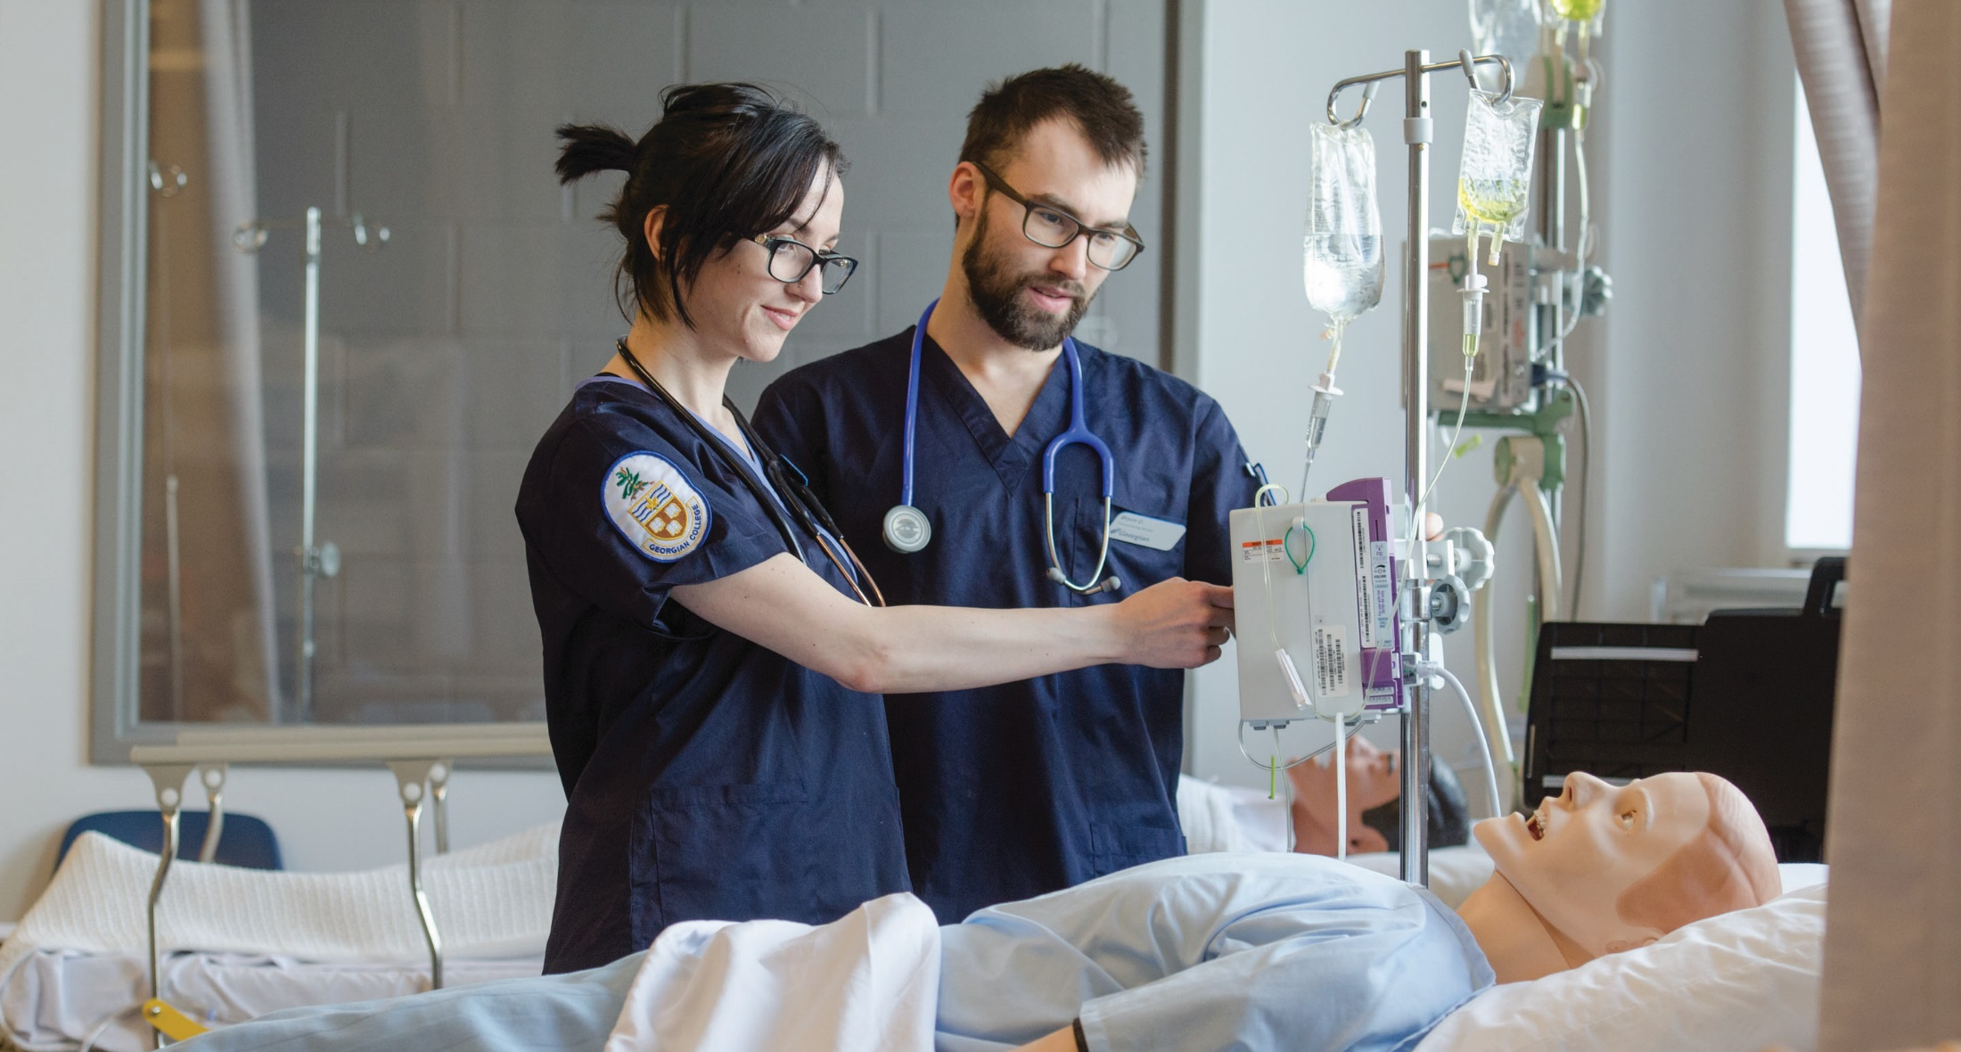
HEALTH, WELLNESS AND SCIENCES
Create healthy communities
Notes:
OPTIONAL SLIDE – Here’s why I think this academic area is unique…
Our Health, Wellness and Sciences curriculum focuses on interprofessional education and patient-centred care.
Quality work placements and outstanding labs allow students to gain valuable experience.
In addition, our students have the opportunity for experiential learning in our clinics, which are open to the public. Clinics include:
Acupuncture Clinic
Georgian College Optical
Nurse Practitioner-led Clinic
Oral Health Clinic
Spa and Esthetics
Speech, Hearing and Language
Student Massage Therapy Clinic
Veterinary Clinic (Orillia Campus)

Slide 18
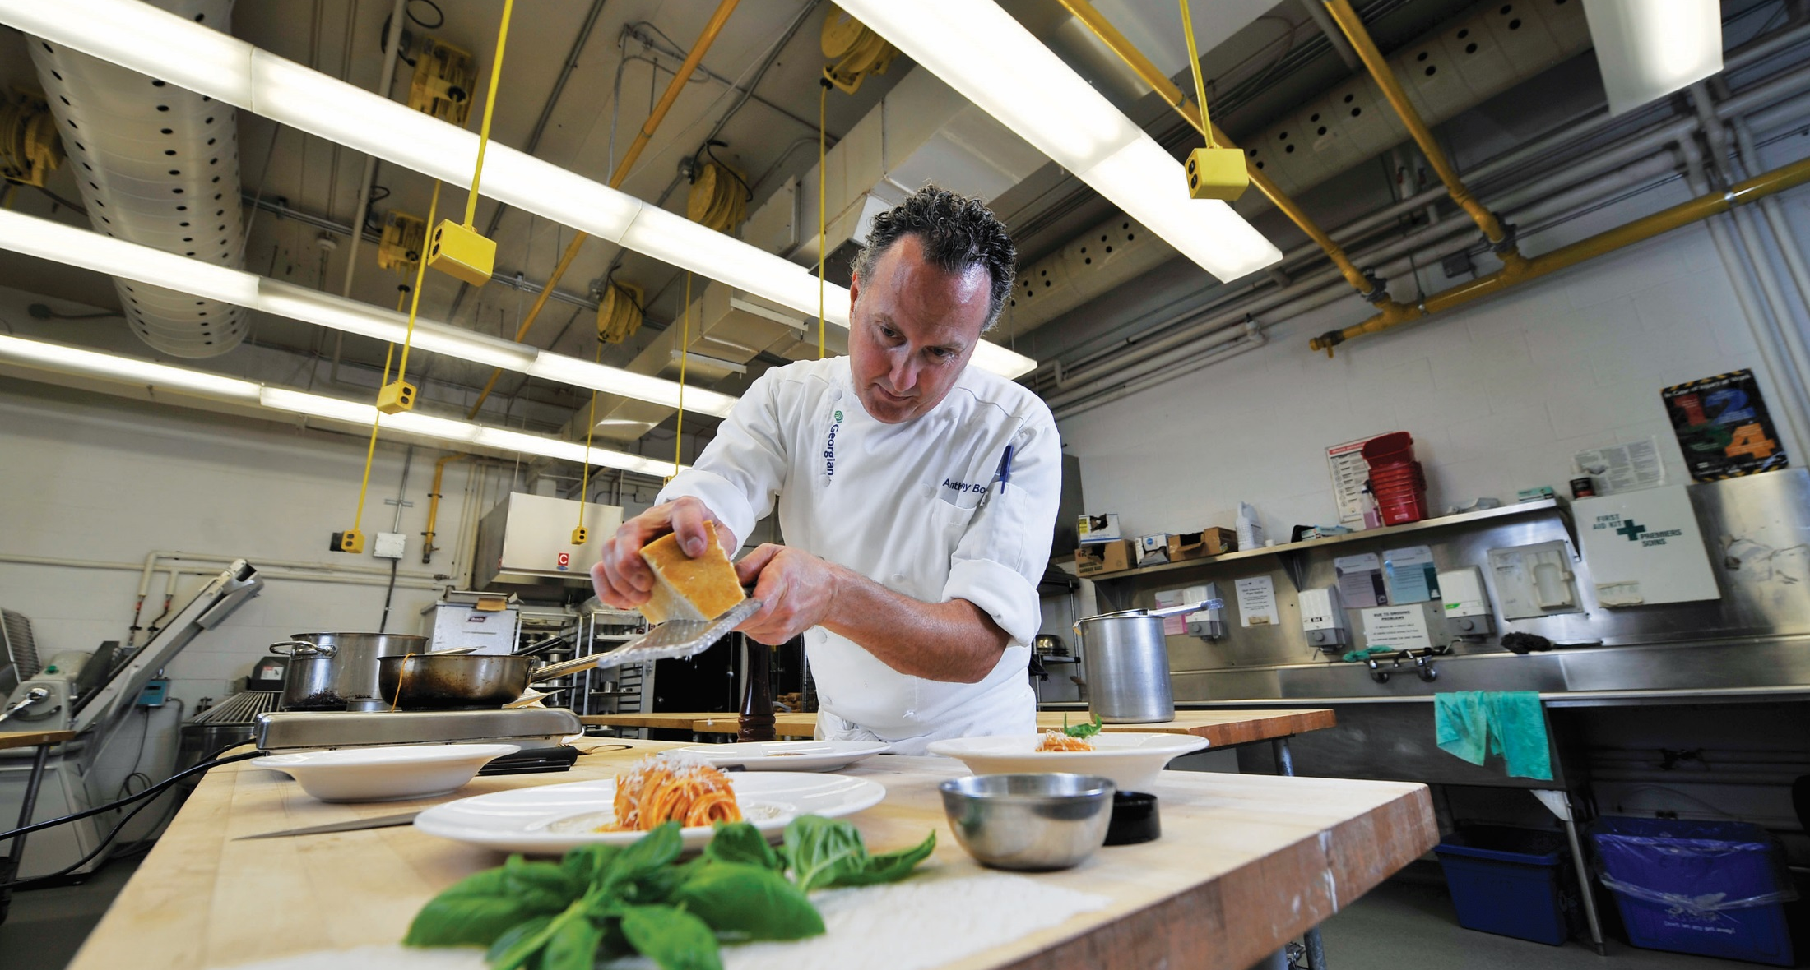
HOSPITALITY, TOURISM
AND RECREATION
Serve up your dream job
Notes:
OPTIONAL SLIDE – Here’s why I think this academic area is unique…
Our location in Central Ontario makes Georgian a wonderful place to learn about and eventually work in Hospitality, Tourism, and Recreation.
This area organizes amazing travel opportunities for students, including a 10-week semester abroad program and a 10-day Euro Tour.
Programs in this academic area are all very closely linked to supportive employer partners.
Our top-rated Georgian Dining Room offers a great place for culinary and hospitality students to build their skills.
We also offer exciting field trips, hands-on learning, industry-experienced faculty and many work experience opportunities to help you prepare for your fast-paced career.

Slide 19
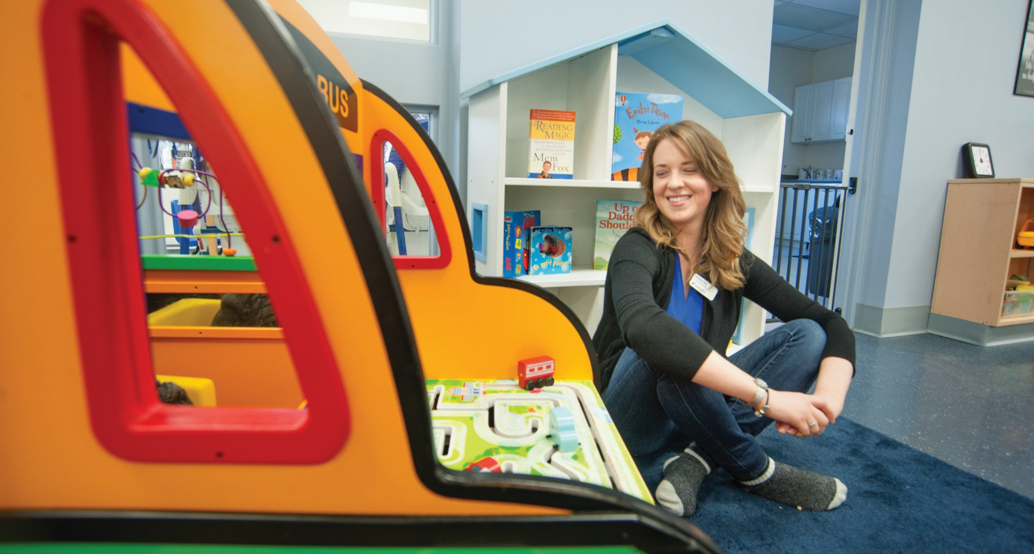
HUMAN SERVICES
Turn passion into a dream career
Notes:
OPTIONAL SLIDE – Here’s why I think this academic area is unique…
Turn your passion for working with people into a career that makes a real difference in society.
Learn from experts and leaders in the field.
Start your career upon graduation or explore our pathways and partnerships to continue your education.
In class, you’ll be encouraged to push traditional boundaries and embrace multiple perspectives.
Counselling labs allow you to use your knowledge.
Partnerships with organizations in the community offer real-world experience.

Slide 20
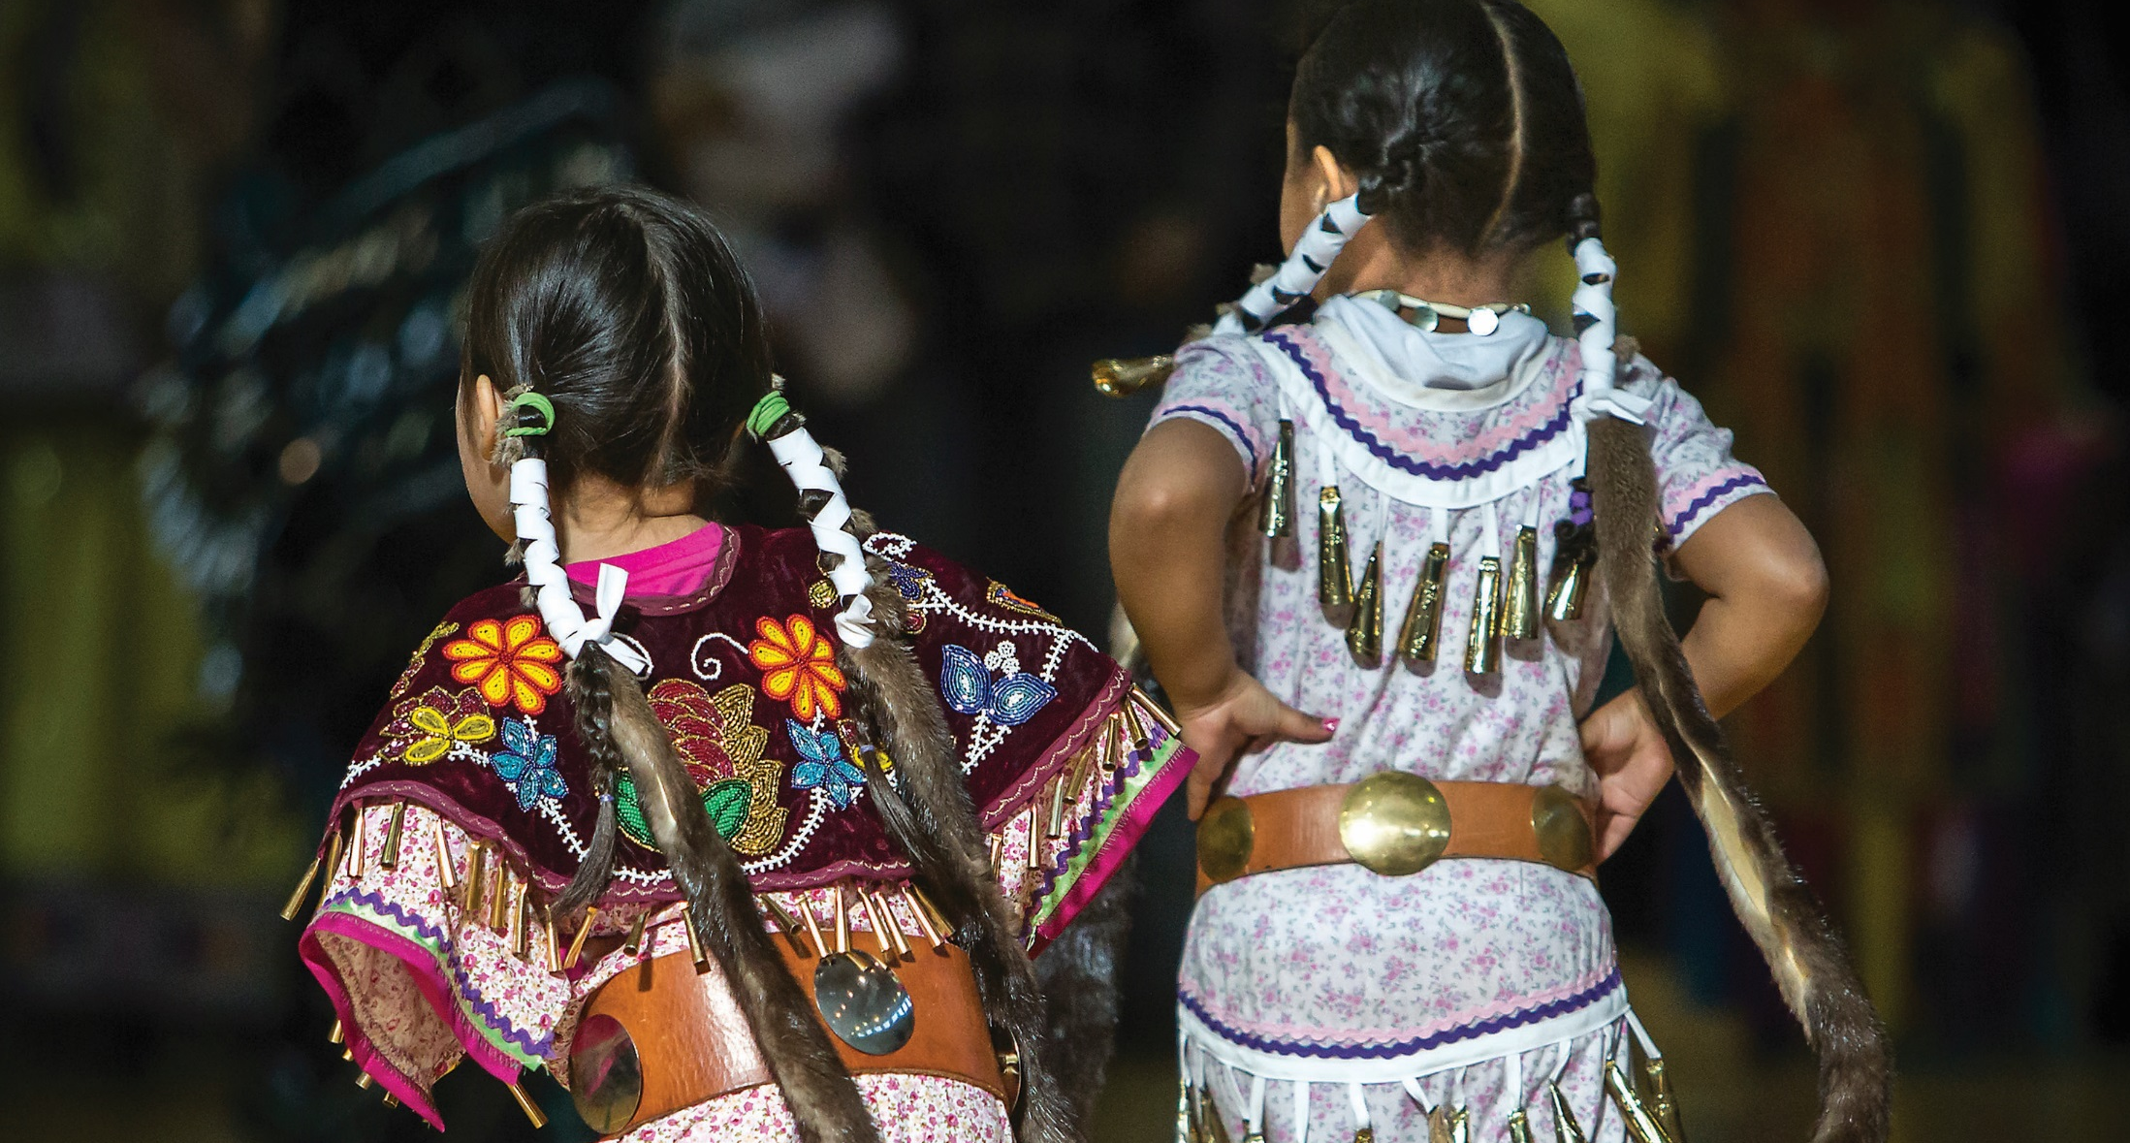
INDIGENOUS STUDIES
Enrich your spirit
Notes:
OPTIONAL SLIDE – Here’s why I think this academic area is unique…
We work with the Anishnaabe Education and Training Circle, a group of 21 communities and organizations, to develop programs and services for First Nations, Métis and Inuit students.
Our programs include a blend of contemporary and traditional teaching methods, with Indigenous cultural values and perspectives embedded in the curriculum.
Our goal is to provide our students with exceptional learning experiences that enhance all areas of their life – physical, mental, emotional and spiritual.
We have Indigenous Resource Centres at four of our campuses, and every year students and staff plan a large Pow Wow attended by thousands of people.

Slide 21

LIBERAL ARTS
Get started on your journey
Notes:
OPTIONAL SLIDE – Here’s why I think this academic area is unique…
Our Liberal Arts programs are wonderful gateways to further learning and are a well-rounded way to continue developing your skills as you make career and education choices.
Gain the knowledge, skills and credentials you need to continue on to a diploma, degree, certificate or job.
Learn written and verbal communication skills, develop your ability to solve problems, how to work well with others, to adapt in a changing workplace, to think independently and make sound judgements.
Learn how to learn in our student-centred environment.

Slide 22

MARINE STUDIES
Navigate your marine career
Notes:
OPTIONAL SLIDE – Here’s why I think this academic area is unique…
Life on a ship is like no other. We offer complete education – and a full year of experience at sea – to get you ready for your marine career.
Learn in Canada’s most advanced marine simulation and research facility from instructors who are qualified experts.
Benefit from our partnerships with Transport Canada and national shipping organizations.
Students in our marine programs – Canada’s premier destination for education in the shipping industry – can enter very lucrative positions upon graduation.

Slide 23
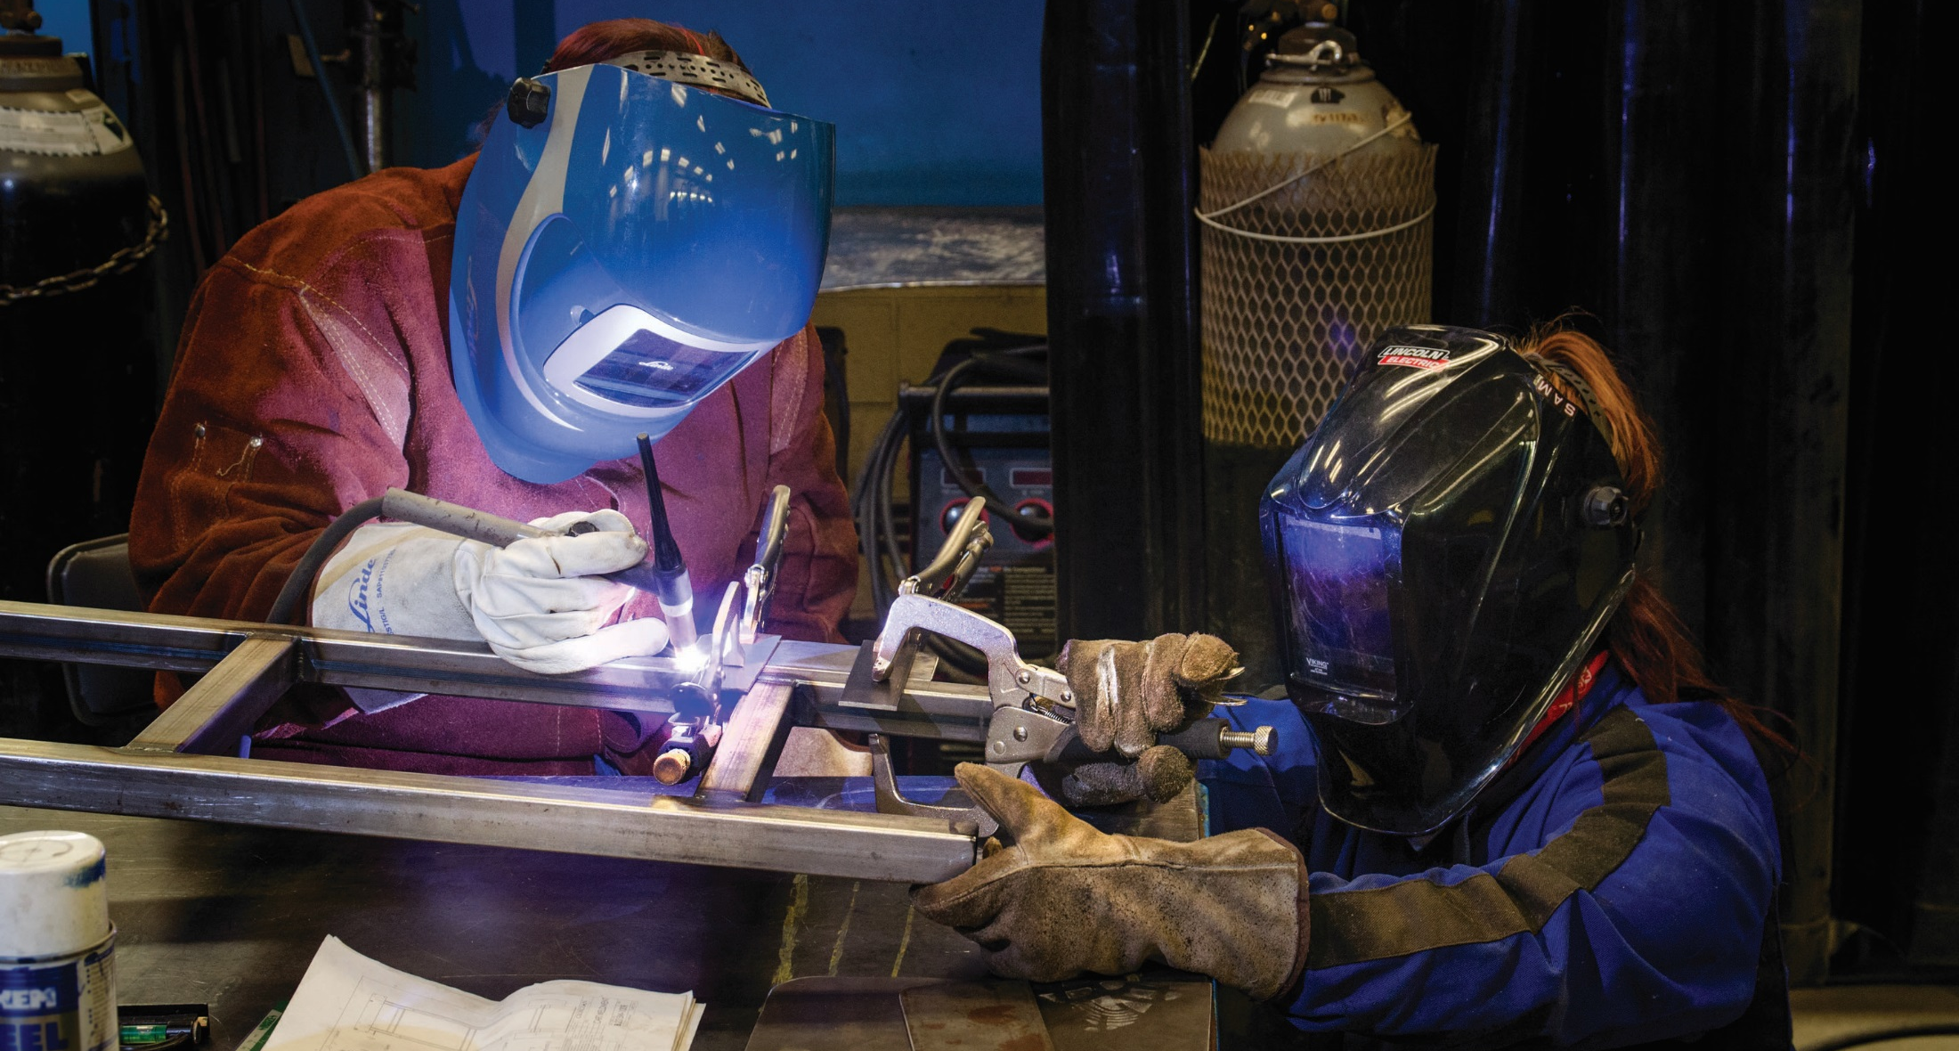
SKILLED TRADES
Build an in-demand career
Notes:
OPTIONAL SLIDE – Here’s why I think this academic area is unique…
There is a shortage of skilled trades workers in Canada, so if you like working with your hands, this is a great time to start.
Georgian has outstanding facilities – including state-of-the-art shops: welding, plumbing, electrical techniques, small engine and marine engine mechanic, carpentry and cabinetry.
There is some classroom time, but you’ll spend most of your education practising skills in our shops.
Our faculty have years of experience in the industry.
We have great employer connections to help you accelerate your career.

Slide 24


Notes:
Video introducing students to Georgian. The video thumbnail will self-load in presentation mode. Click on the thumbnail to play the video.
Before I turn it over to someone who has experienced Georgian firsthand, I want to play a quick video that’ll show how we can accelerate your success.
HERE YOU CAN EITHER LINK TO AN ACADEMIC AREA VIDEO (LIST IS ON THE STAFF PORTAL) OR USE THIS EXPERIENCE GEORGIAN VIDEO.

Slide 25
NAME OF ALUMNUS
Job title, workplace
Georgian program, year of graduation
Notes:
Suggested speaking points
Now I’d like to introduce you to [alumnus full name]. [Read biography – job title will be on slide]
[alumnus first name], thank you so much for being here today to share your story. Over to you.
__________________________________
AFTER ALUMNUS PRESENTATION:
Thanks [first name]. [comment on an element of their presentation]
You’ll have an opportunity to ask [first name] questions shortly.

Slide 26
NAME OF EMPLOYER
Job title, workplace
Notes:
Suggested speaking points
First I’m going to introduce you to [name of employer rep].
We’ve enjoyed a relationship with [employer org] for [approximate number of years.] [briefly describe relationship]
Come on up, [employer rep].
__________________________________
AFTER EMPLOYER PRESENTATION:
Thanks [employer rep] for providing insights into how students can work with you to accelerate their careers. [feel free to add another comment on presentation]

Slide 27
Questions?
Notes:
Suggested speaking points
Now we’re going to open the floor for about 20 minutes.
Does anyone have questions for [alumnus first name], [employer rep], or myself?
[after 18 minutes, wrap things up] We have time for just one more question.

Slide 28
Notes:
Thanks to all of you for your great questions.
Before our guest speakers leave the stage, I want to present them with a thank you gift from Georgian. [Insert names] we so appreciated your time and insight today.
Let’s give a round of applause to our speakers. [initiate applause]
In a few minutes I’ll post contact information for [academic area name] on the screen.
If you have more questions about Georgian, don’t hesitate to reach out to us. We’re happy to help.

Slide 29
Other things to do today
Take a campus tours: Room _____, building ____
Accept your offer or pay your deposit: Room ______, building __
Connect with financial aid: Room ________, building ___
Learn about housing: Room ________, building ___
Notes:
Before we get to networking and food, I want to tell you about some of the other things you can do while you’re on campus today:
If you haven’t done a campus tour, go to [insert room number] where our students are waiting to show you around.
If you’re ready to accept your offer or pay your deposit, visit [insert room number]. Anyone who accepts or pays today will receive a special gift.
You can also go to [room number] to connect with someone from financial aid. We offer outstanding bursaries and scholarships and can answer your questions about OSAP.
If you’re interested in learning about housing options, go to [insert room number].
[NOT MIDLAND] I’d also encourage you to visit Bear Essentials, our campus store, in [building name] to learn about course materials.
We’ll be doing the draw for the $5,000 tuition grant early next week. By signing in to this event, you’ve been entered into the contest. The winner will be sent an email.

Slide 30
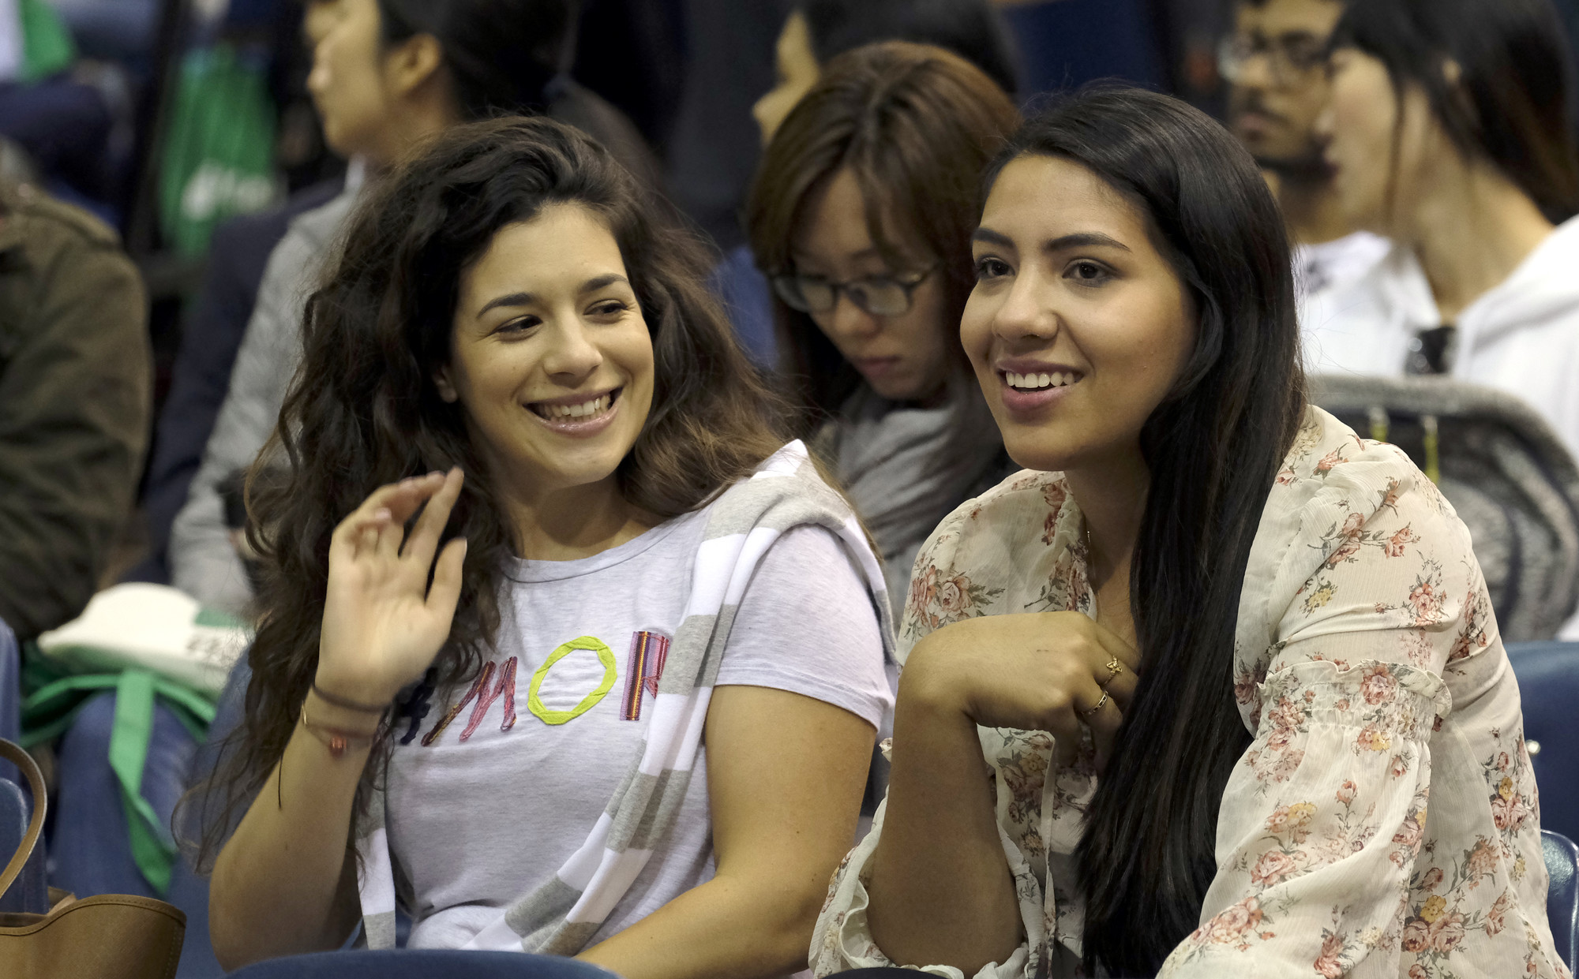
GET CONNECTED and ORIENTATION
Notes:
Suggested speaking points
I’d also like to invite you to check out Get Connected, which is an event we host to prepare you for your first term.
At Get Connected you can do things like:
Pick up your student ONEcard
[BARRIE ONLY]Grab your buss pass
Order your books
Learn about health insurance
Connect with your student advisor
Explore IT services like the student portal, Banner, Blackboard and student email
And lots more
Some of the dates for Get Connected and Orientation have been posted at GeorgianCollege.ca/orientation.
You should receive an email about them a few weeks before the term starts.

Slide 31
[NAME OF ACADEMIC AREA]
Contact us
Name
Email
Phone number
Name
Email
Phone number
Notes:
Suggested speaking points
That concludes the speaking part of this event.
Please help yourselves to snacks and beverages.
[alumnus name], [employer name], and I will be here for another hour or so. We’re happy to answer your questions one on one. Don’t be shy.
There are other Georgian staff and faculty members here today who would be happy to talk to you. We’re all wearing nametags. Can I get a wave from Georgian employees? [wait for wave]
Our contact information is on the screen, if you have questions after this event.
Thanks again for coming! And enjoy the rest of your time on campus.

Slide 32
Notes:
Change to this static slide after your event ends

